Slide 1

Data-driven predictive modeling for the analysis, forecasting and management of the ongoing COVID-19 epidemic
Edwin Michael, PhD
Ken Newcomb, PhD
College of Public Health
Making Life Better ®
2.23.2021

Slide 2
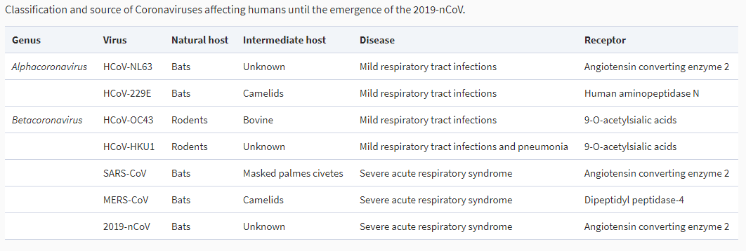
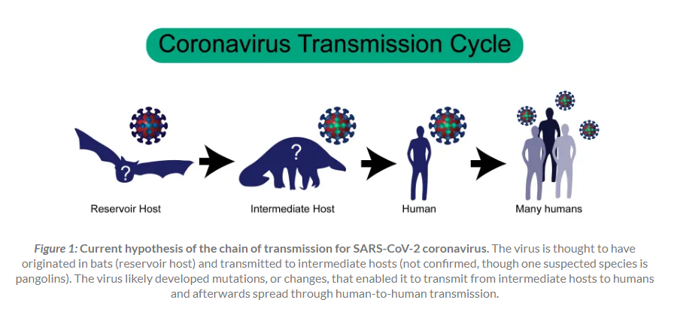
EMERGENCE AND SPREAD OF A NOVEL EMERGING/ZOONOTIC RESPIRATORY PANDEMIC: SARS-CoV-2
15-30% of common colds in humans

Slide 3
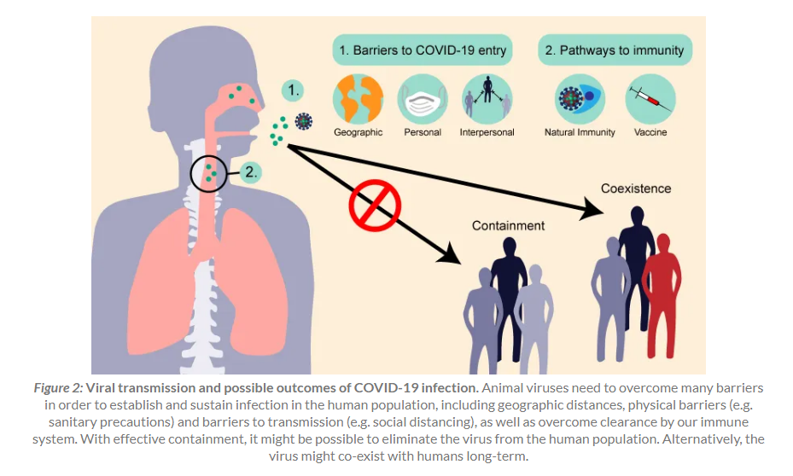
DIRECT PERSON-TO-PERSON TRANSMISSION AND POSSIBLE OUTCOMES OF COVID-19 INFECTION

Slide 4
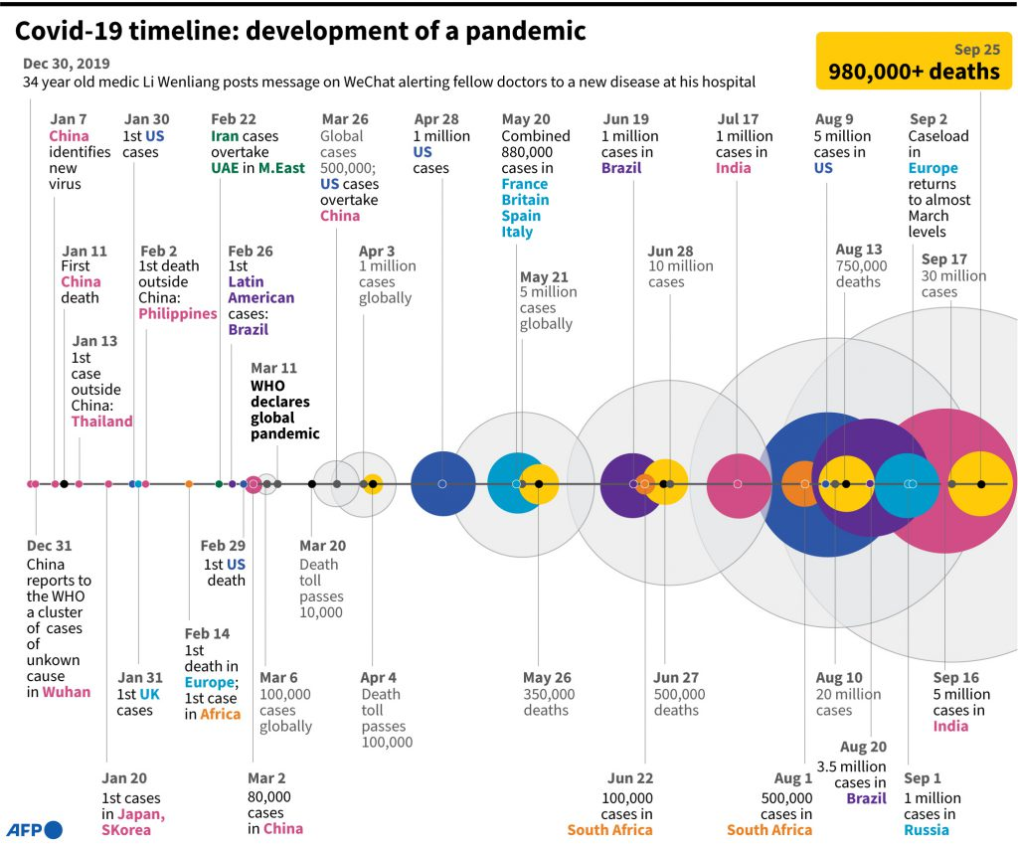
RAPID GLOBAL SPREAD (global connectivity, susceptible populations, low initial containment measures)
112M cases
2.48M deaths
219 countries
(Feb 22, 2021)

Slide 5
Forecasting the course and management of the pandemic
Log(linear) models fit to epicurves of incidence data – r (growth rate), doubling time (Td), and R (basic or effective Reproductiive number (ave number of secondary cases caused by a primary case)
- dependendent on quality of data through time, cannot accommodate time periods with no data, difficult to assess impacts of interventions
Time series forecasting models – can project growth of cases
- statistical, out-of-sample projection problems, difficult to capture exponential phases and evaluate impacts of interventions
Dynamic mathematical models – process based, can simulate transmission dynamics as a function of non-linear interactions between different groups involved in transmission, can estimate R dynamically, can simulate interventions
- requires data on transmission structures, population size, initial conditions, regular updating with data, and agility for incorporating new model structures rapidly

Slide 6
Development of SEIRcast: context
Mathematical models of virus transmission dynamics at the local level will play an increasingly important role for response planning in combating and managing the current COVID-19 outbreak
SEIR compartmental models for COVID19 transmission accounting for local transmission conditions, including impacts of locally-applied social interventions, can facilitate forecasts of the course of the COVID-19 epidemic
These models can be used to inform hospital capacity and resource planning for meeting the expected demand for beds, ventilators, ICU units, including estimating the dates for peak demand and when current capacity will be exceeded
We use Bayesian calibration methods that allow updating of our models sequentially as data on the outbreak evolves together with estimation of uncertainties in the generated forecasts
Requirement for continual changes in model structures to address newly emerging interventions, eg. vaccinations, and evolution of transmission novelties, eg. new variants
Development of dashboards that can couple data with iterative model fitting and predictions will ensure that the latest projections are available for decision making and planning: https://seircast.org/app/

Slide 7
Our extended SEIR-based COVID-19 Model [Updated: Jan 11]
Quarantined - Asymptomatic
(Q₁)
Booster (B)
f
γ_{Q}
(1-𝜀_{v})
𝜉2
q*z
Vaccinated (V)
Infectious –
Asymptomatic (I_{A})
Recovered (R)
(1-𝜀_{v})
(1-q)γ_{A}
𝜉1
σ*ρ
Susceptible (S)
d*β
Exposed (E)
(1- q-x₁)*γ_{M}
σ*(1- ρ)
(1-x₂)*γ_{H}
(1-x₃)*γ_{C}
α
λ
d*β
Restricted Mobility
(M₁)
Vaccine-Refusing (S2)
Infectious –
Presymptomatic (I_{P})
Infectious –
Symptomatic (mild) (I_{M})
Infectious –
Symptomatic (hospital) (I_{H})
Infectious –
Symptomatic (ICU/Vent) (I_{C})
(1-q)δ₁
x₁*δ₂
x₂*δ₃
α
λ
Restricted Mobility
(M₂)
x₃m
q*z
p* δ_{Q}
f
q*z
Died (D)
Based on compartmental models of disease transmission which model the spread of disease in a population by dividing the host population into various compartments and transmission is simulated through flows of hosts between these compartments
Quarantined – Presym/Mild
(Q₂)
(1-p)γ_{Q}
Notes:
<beta> = proportion_1*beta1 + proportion_2*beta2
1.5 = 0.95*beta1 + 0.05*beta1*3
1.5 = 0.95*beta1 + 0.15*beta1
1.5 = 1.1*beta1
Beta1 = 1.5/1.1 = 1.36, beta2 = 4.09
0.25% and 0.15% -- > 0.0025*S

Slide 8
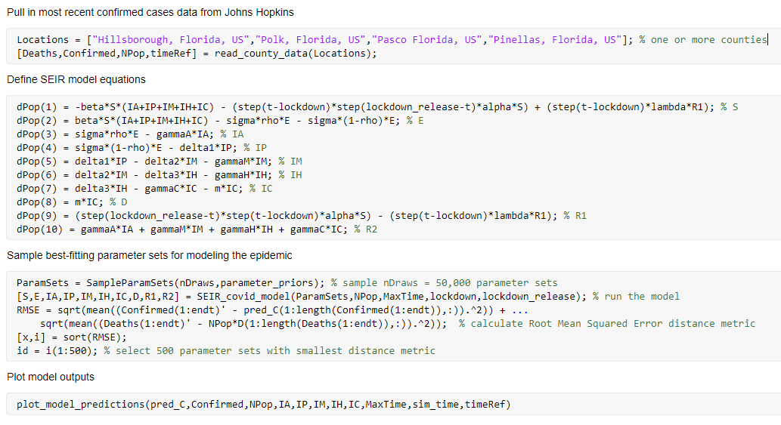
Model code (overview): advances in programming, data and computer science. and numerical analysis
Automated using Continuous Integration (CI)

Slide 9
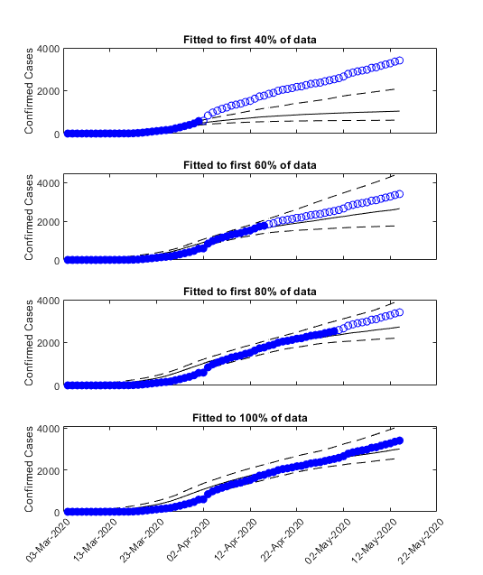
Data-driven: sequential fitting to incoming data
Our sequential Bayesian calibration method can use evolving incoming data to update model parameters as the local disease outbreak takes shape
The graphs show how this model updating given data collected from early to later phases of the outbreak can reduce forecast uncertainty over time (note span of y-axis)
We update model parameters using 10-day blocks of data sequentially through time

Slide 10
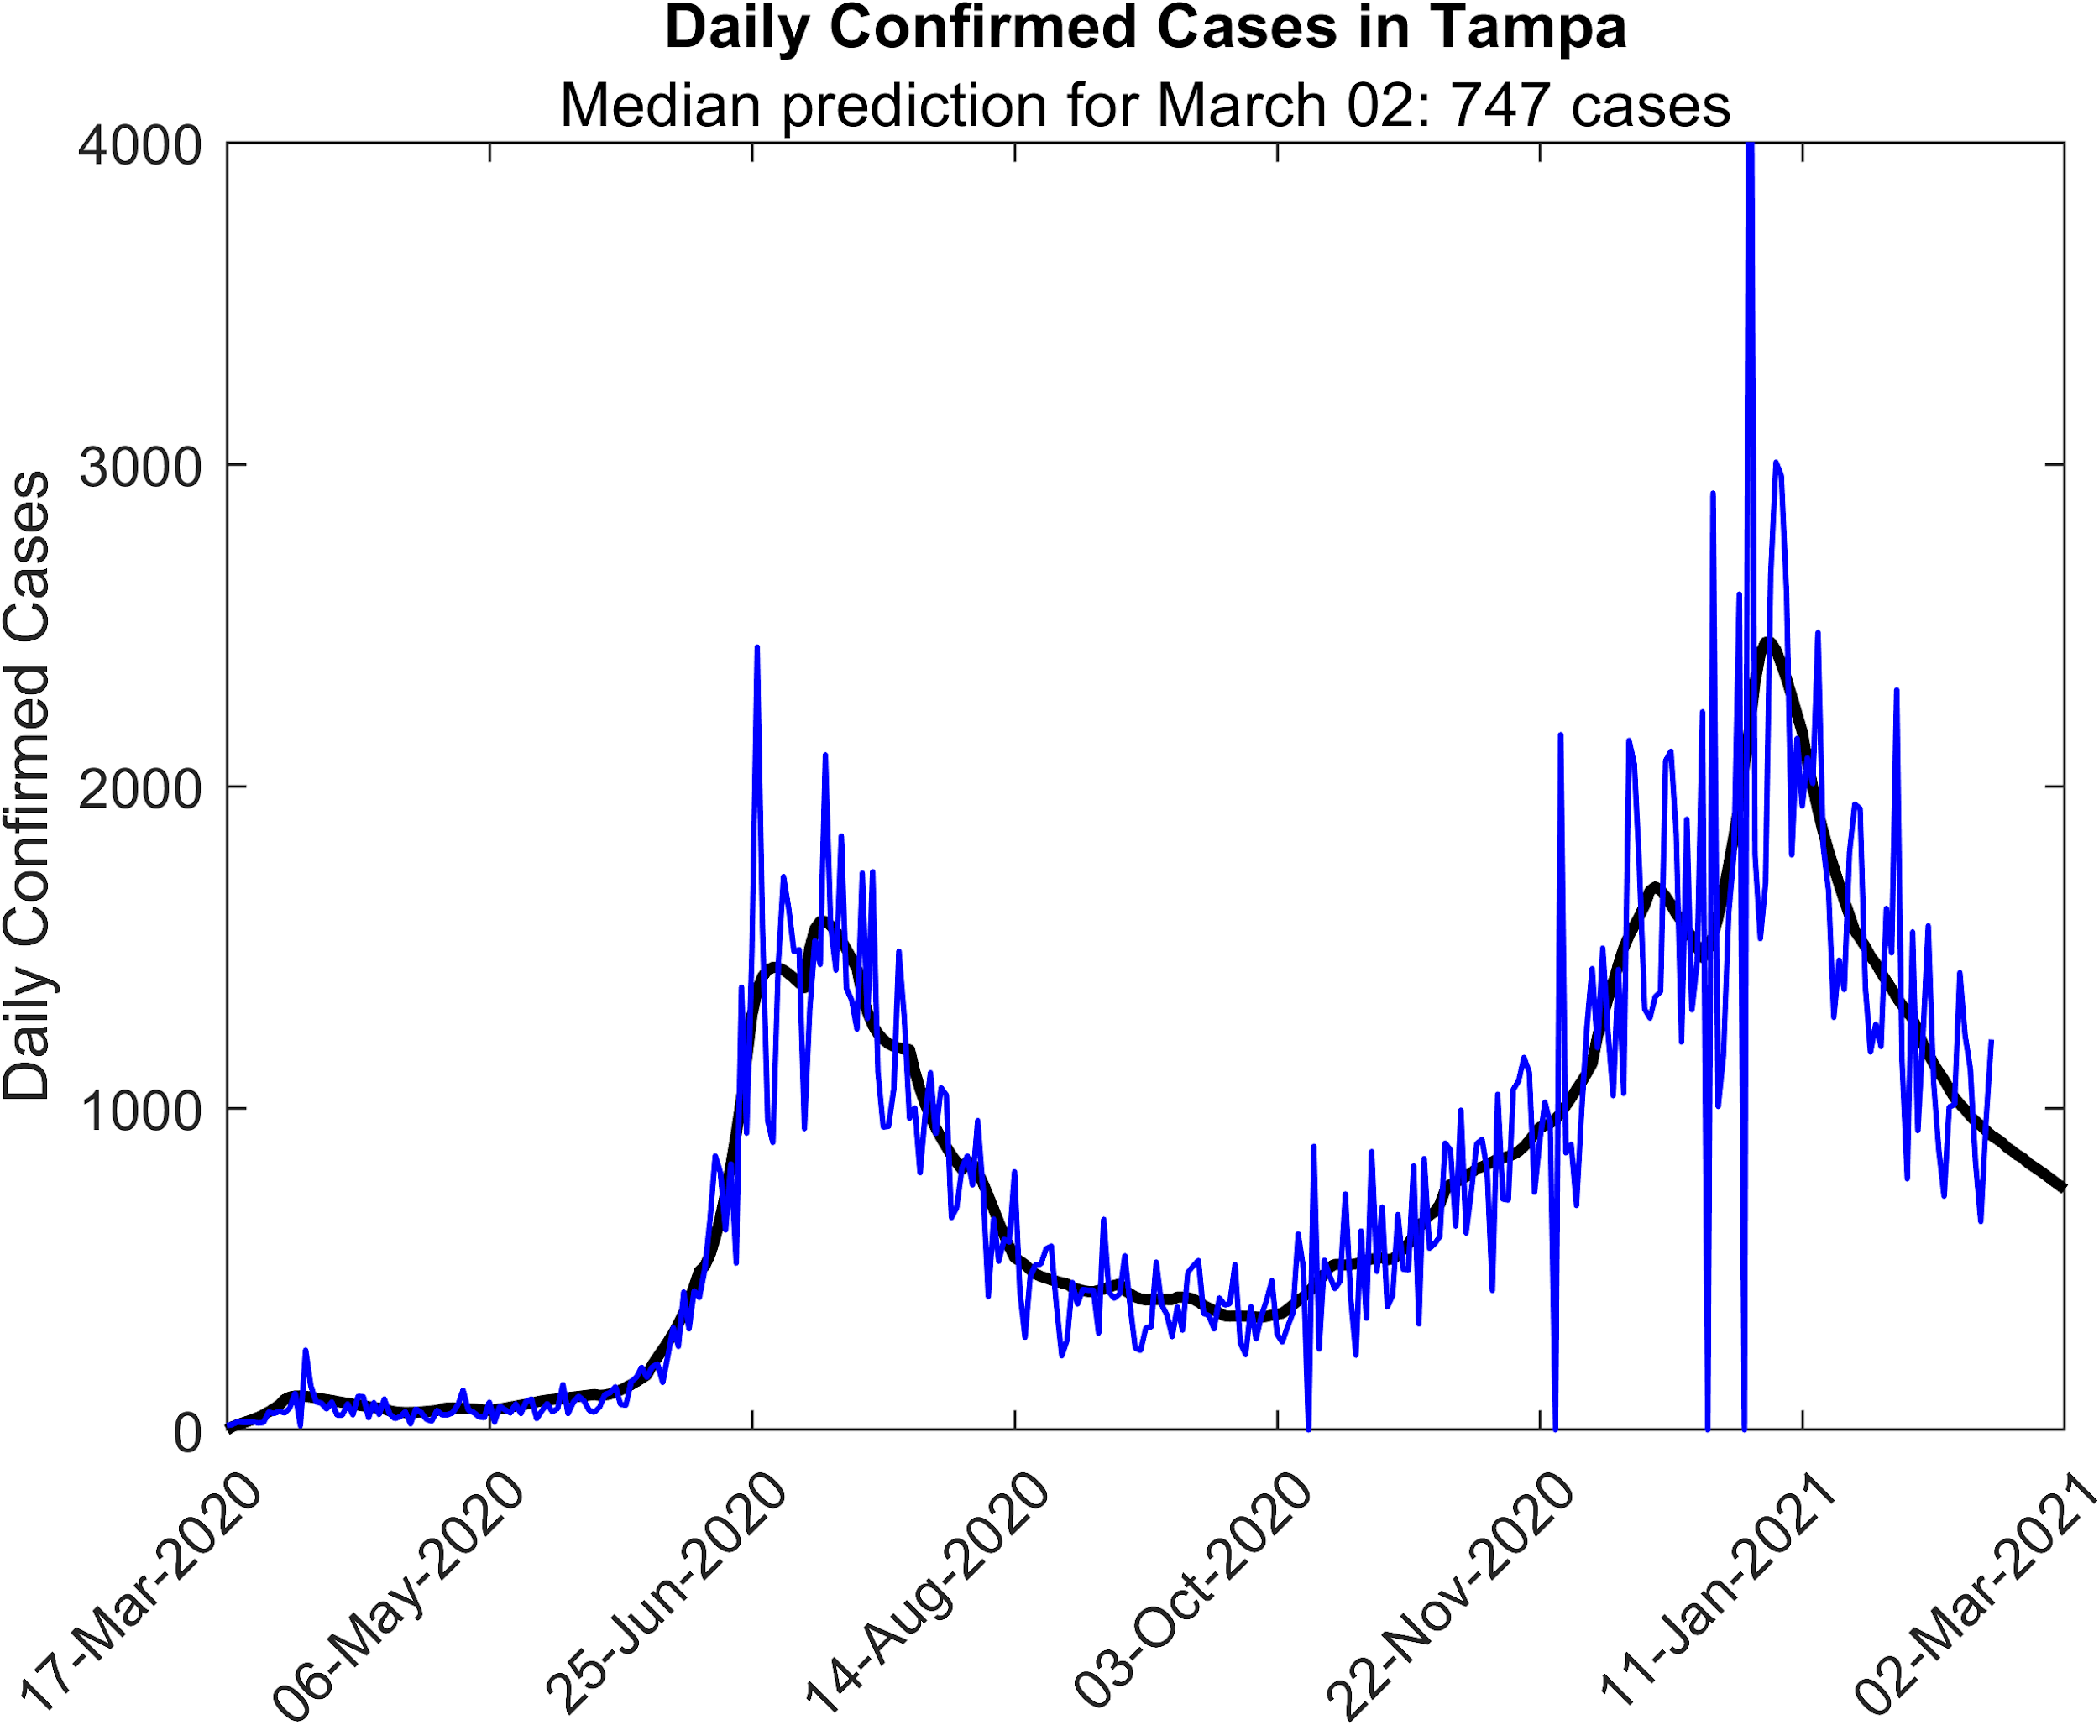
Latest SEIRcast fit to data and near-term forecasts of daily confirmed cases for Tampa Bay to Mar 2 given current social conditions and vaccinations from Feb 15
3rd wave peak occurred 1st week of Jan following which the pandemic has been in decline
Social mandates led to reduction in cases, while Reopening mandates led to resurgence of the pandemic
Jan 2021 spike due to holiday social activities: importance of social behaviour
6/22
Face masks
6/26
Bars closed
8/31
Schools
Reopen
9/14
Bars
Reopen
9/28
Statewide
Reopening
12/17
Mask mandate/
Vaccinations
- Update model as of 02.17.2020 (40% protection against transmission by social measures)
Newcomb et al. (2020) Sci Rep (submitted) doi: 10.21203/rs.3.rs-96665/v1
https://seircast.org/app/
β = w1*β(1) + w2*β(2)

Slide 11
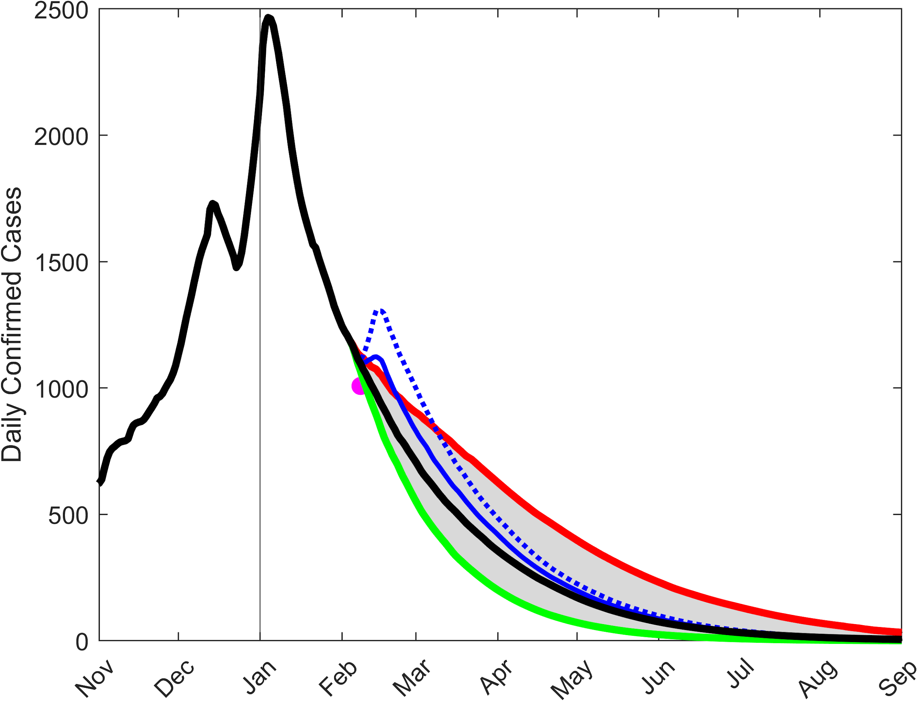
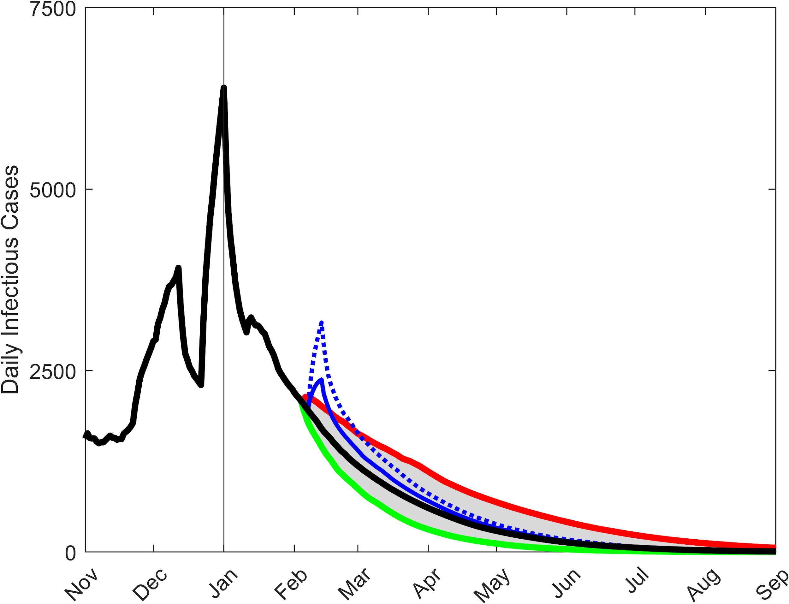
SEIRcast forecasts of daily confirmed/total infectious cases to the end of Sept 2021 given current beta (= capturing social measures) and vaccination roll out rate (0.0013 per day= 12,000 vaccinations per wk in Hillsborough)
Assuming 65% effective vaccine, 80% effective booster
Total Daily Confirmed Cases
Total Daily Infectious Cases
Maintaining social measures
10% release of social measures
10% strengthening of social measures
Super Bowl effects: 2% of 12,500 visitors
Infected and 25% or 50% relaxation of
Prevailing social measures
Transient Super Bowl impact
10 Feb: 1,402
12 Feb: 1,101
8 Feb: 1,001
17 Feb: 843
14 Feb: 649
Notes:
----Plot until September
----Dashed line bring to front
----Thin super bowl lines
Run Super Bowl from Sunday to Sunday
Point (Feb 8th, 1008)

Slide 12
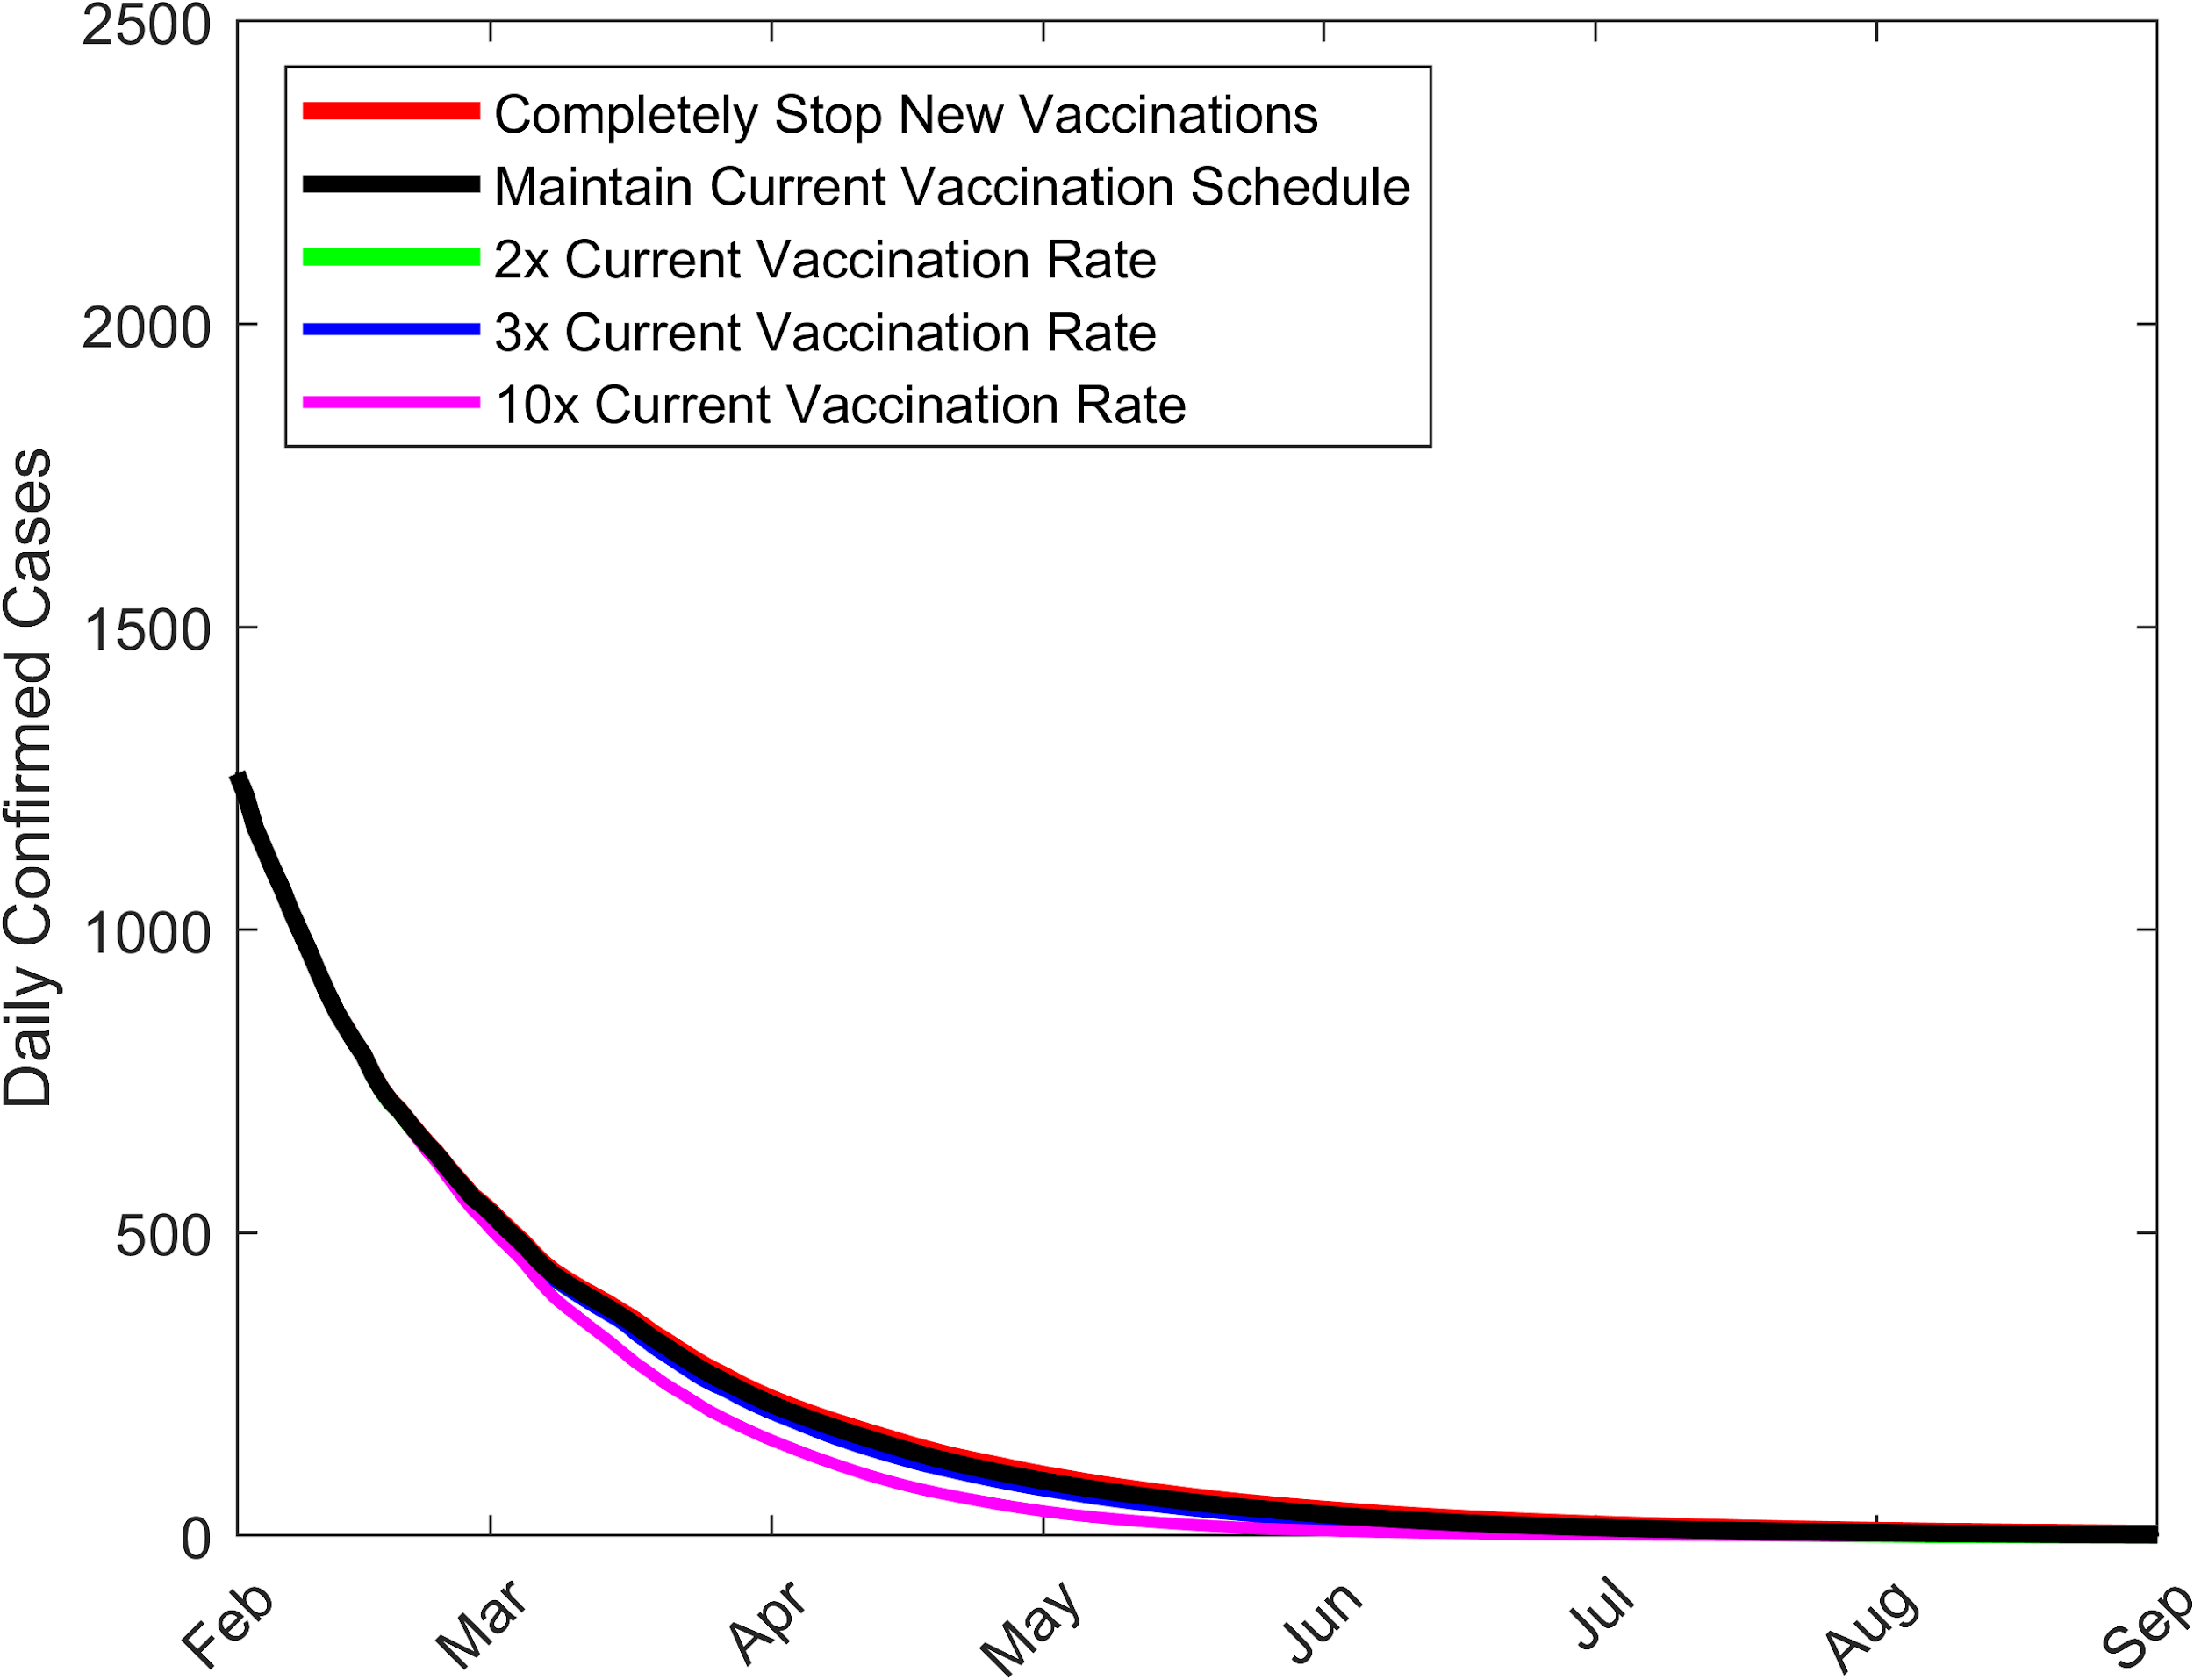
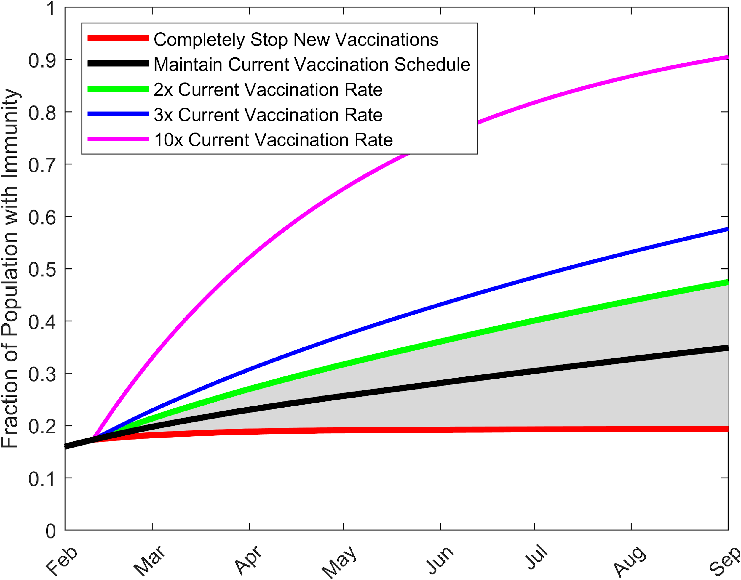
Reasons for decline: Isolating the Effect of Vaccination
Daily Confirmed Cases
Fraction with Natural Immunity, Vaccine, or Booster
Herd immunity level w.o. social measures
Social measures are the dominant cause of decline!
Herd immunity level w. social measures
Social measures will retard development of herd immunity
Vaccination will be critical to developing herd immunity

Slide 13
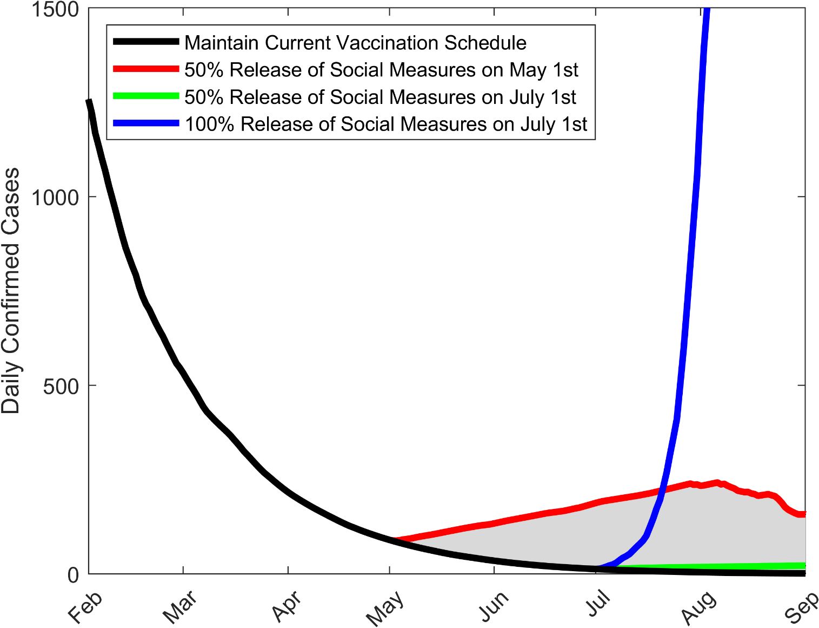
The Dominant Effect of Social Measures for Pandemic Decline
Daily Confirmed Cases
Full release of social measures on 1st July
50% release on May 1st will lead to a moderate resurgence with vaccination at current rates
Caveats:
Does not take account for variants and lower efficacy of vaccines against mutants
Releasing social measures before pandemic end can lead to increased spread of variants
50% release on July 1st will lead to only a slight increase in cases with vaccination at current rates
Notes:
d = 0.25 (75% protection)
0.25*beta*S
82.5% restricted mobility + social measures (masks, distance)

Slide 14
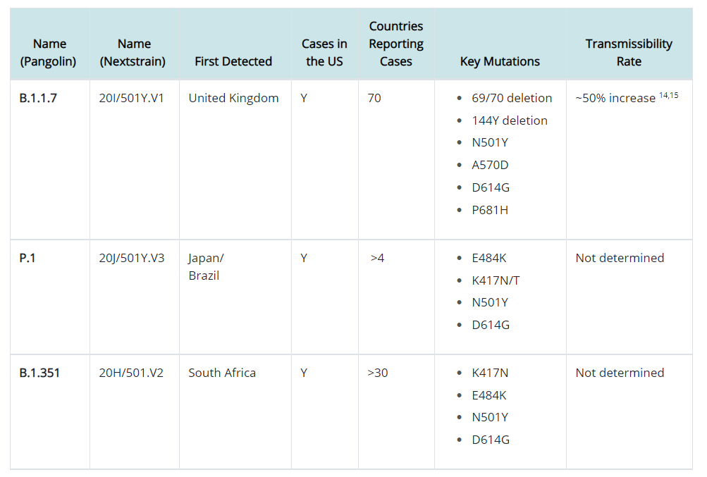
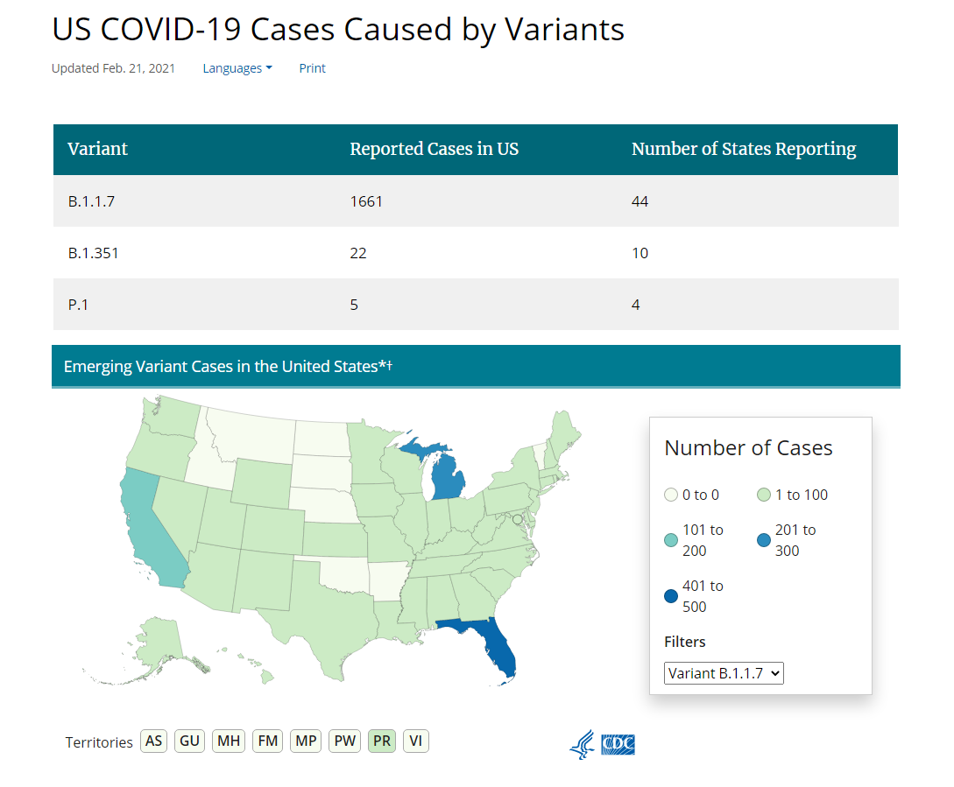
Emergence and spread of major SARS-Cov-2 variants
UK variant
Dec, 2020
Brazilian variant
Jan, 2021
SA variant
Jan, 2021

Slide 15
Modelling impact of SARS-Cov-2 variants with vaccination
Diagram of a two-variant COVID-19 model with vaccination

Slide 16
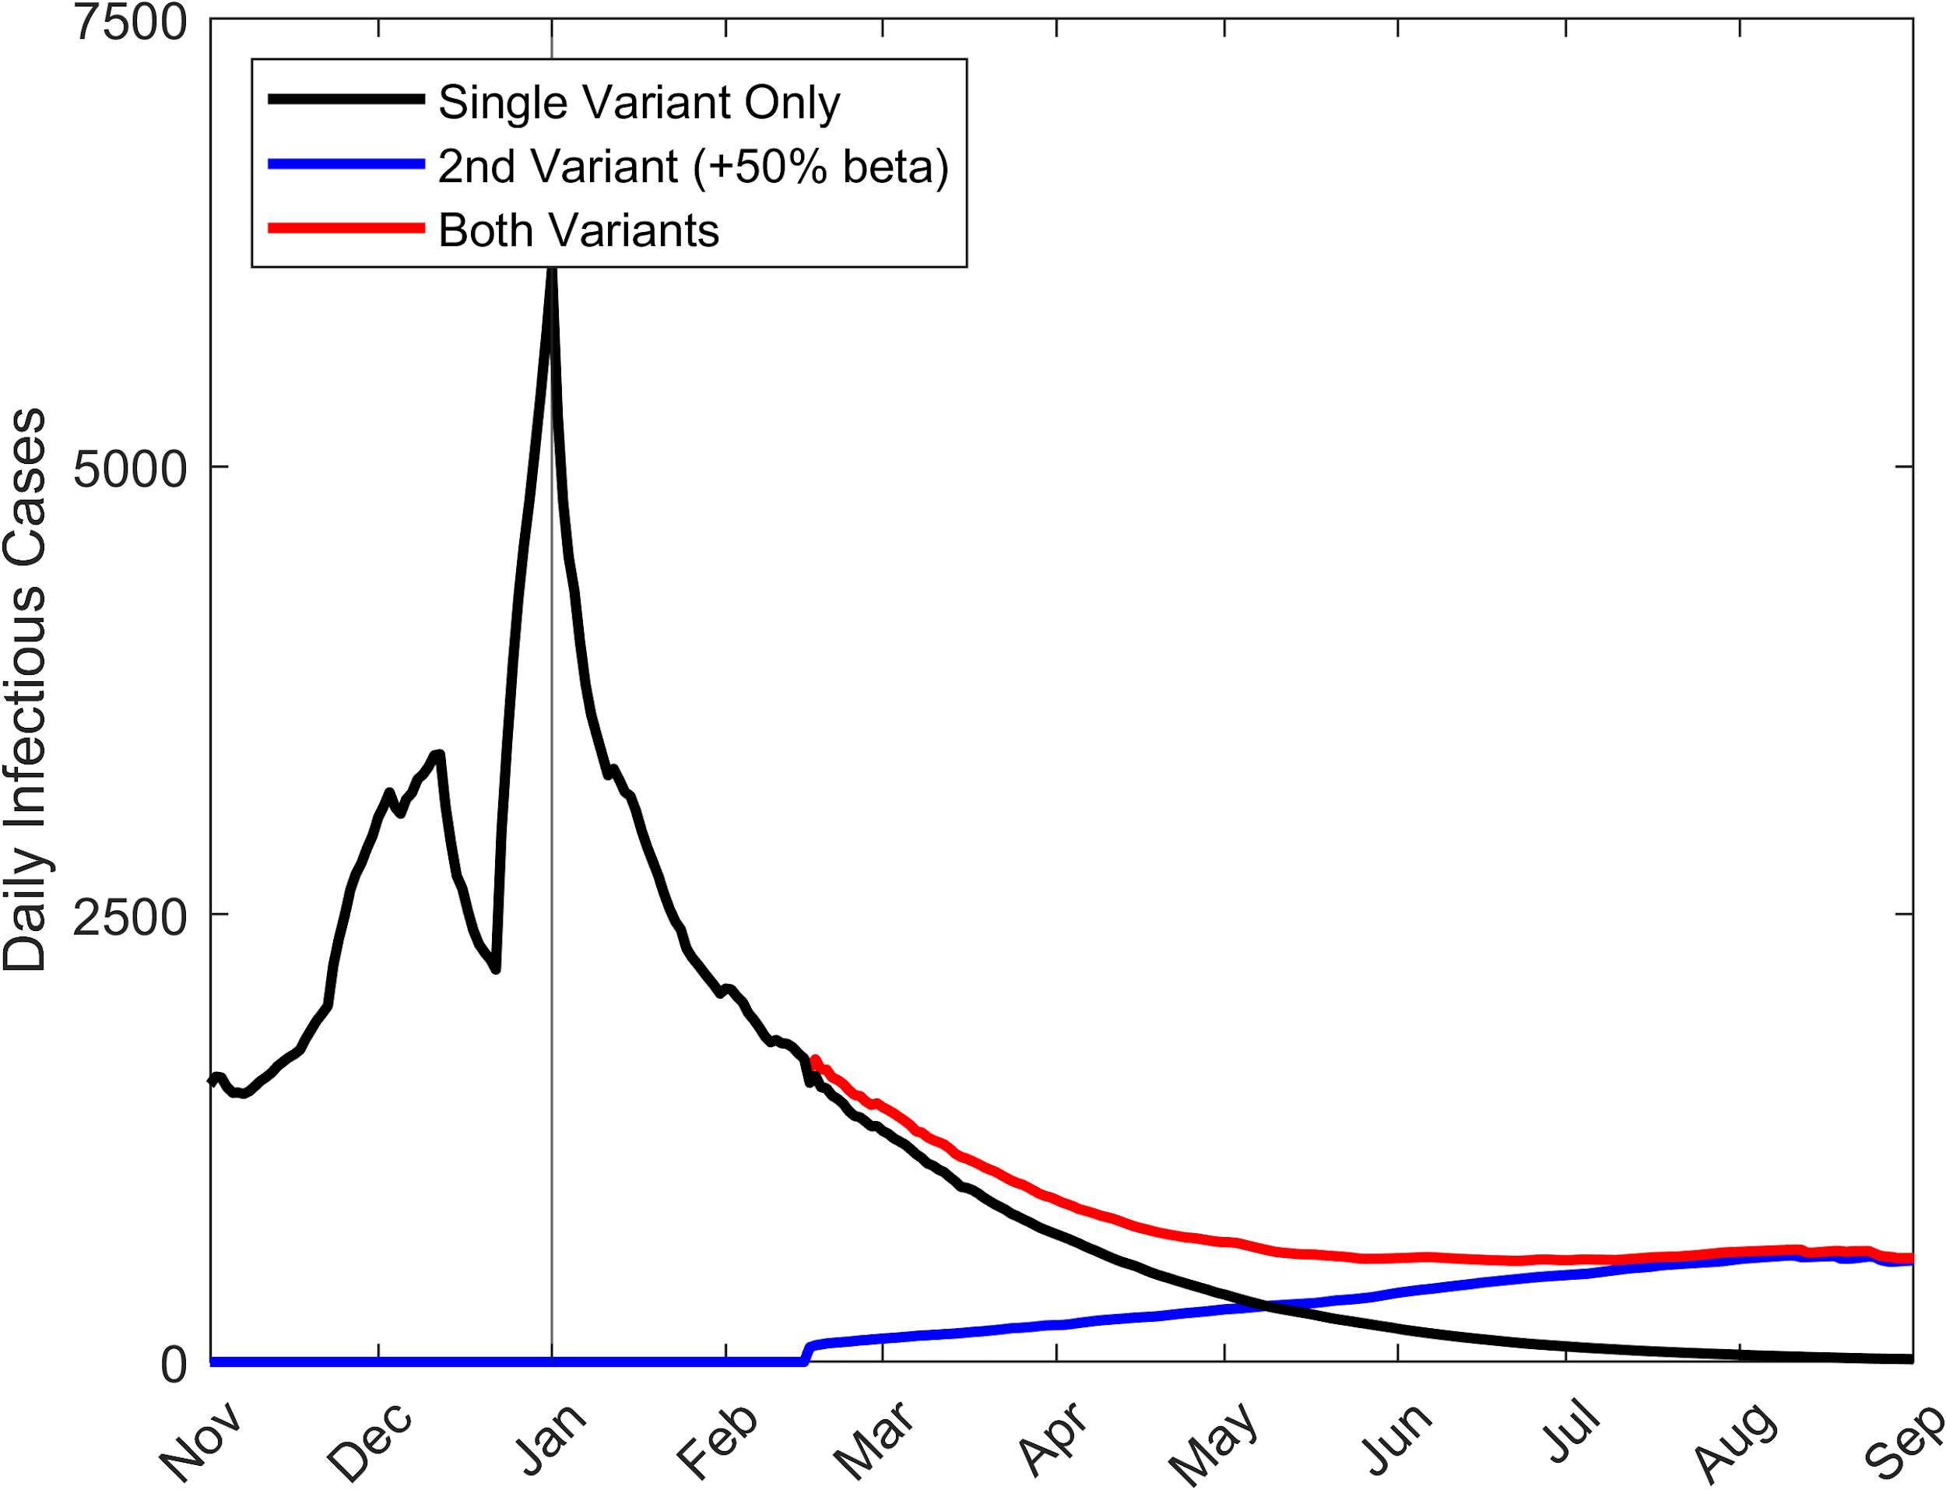
Prelim 2-Variant Model Forecasts (initial incidence: 5%, 50% more transmissible)
The new variant will spread and replace the old variant but the spread will be constrained given the ongoing current social measures
Simulation of cases decomposed by variants with current social measures and vaccinations
Notes:
Thin lines

Slide 17
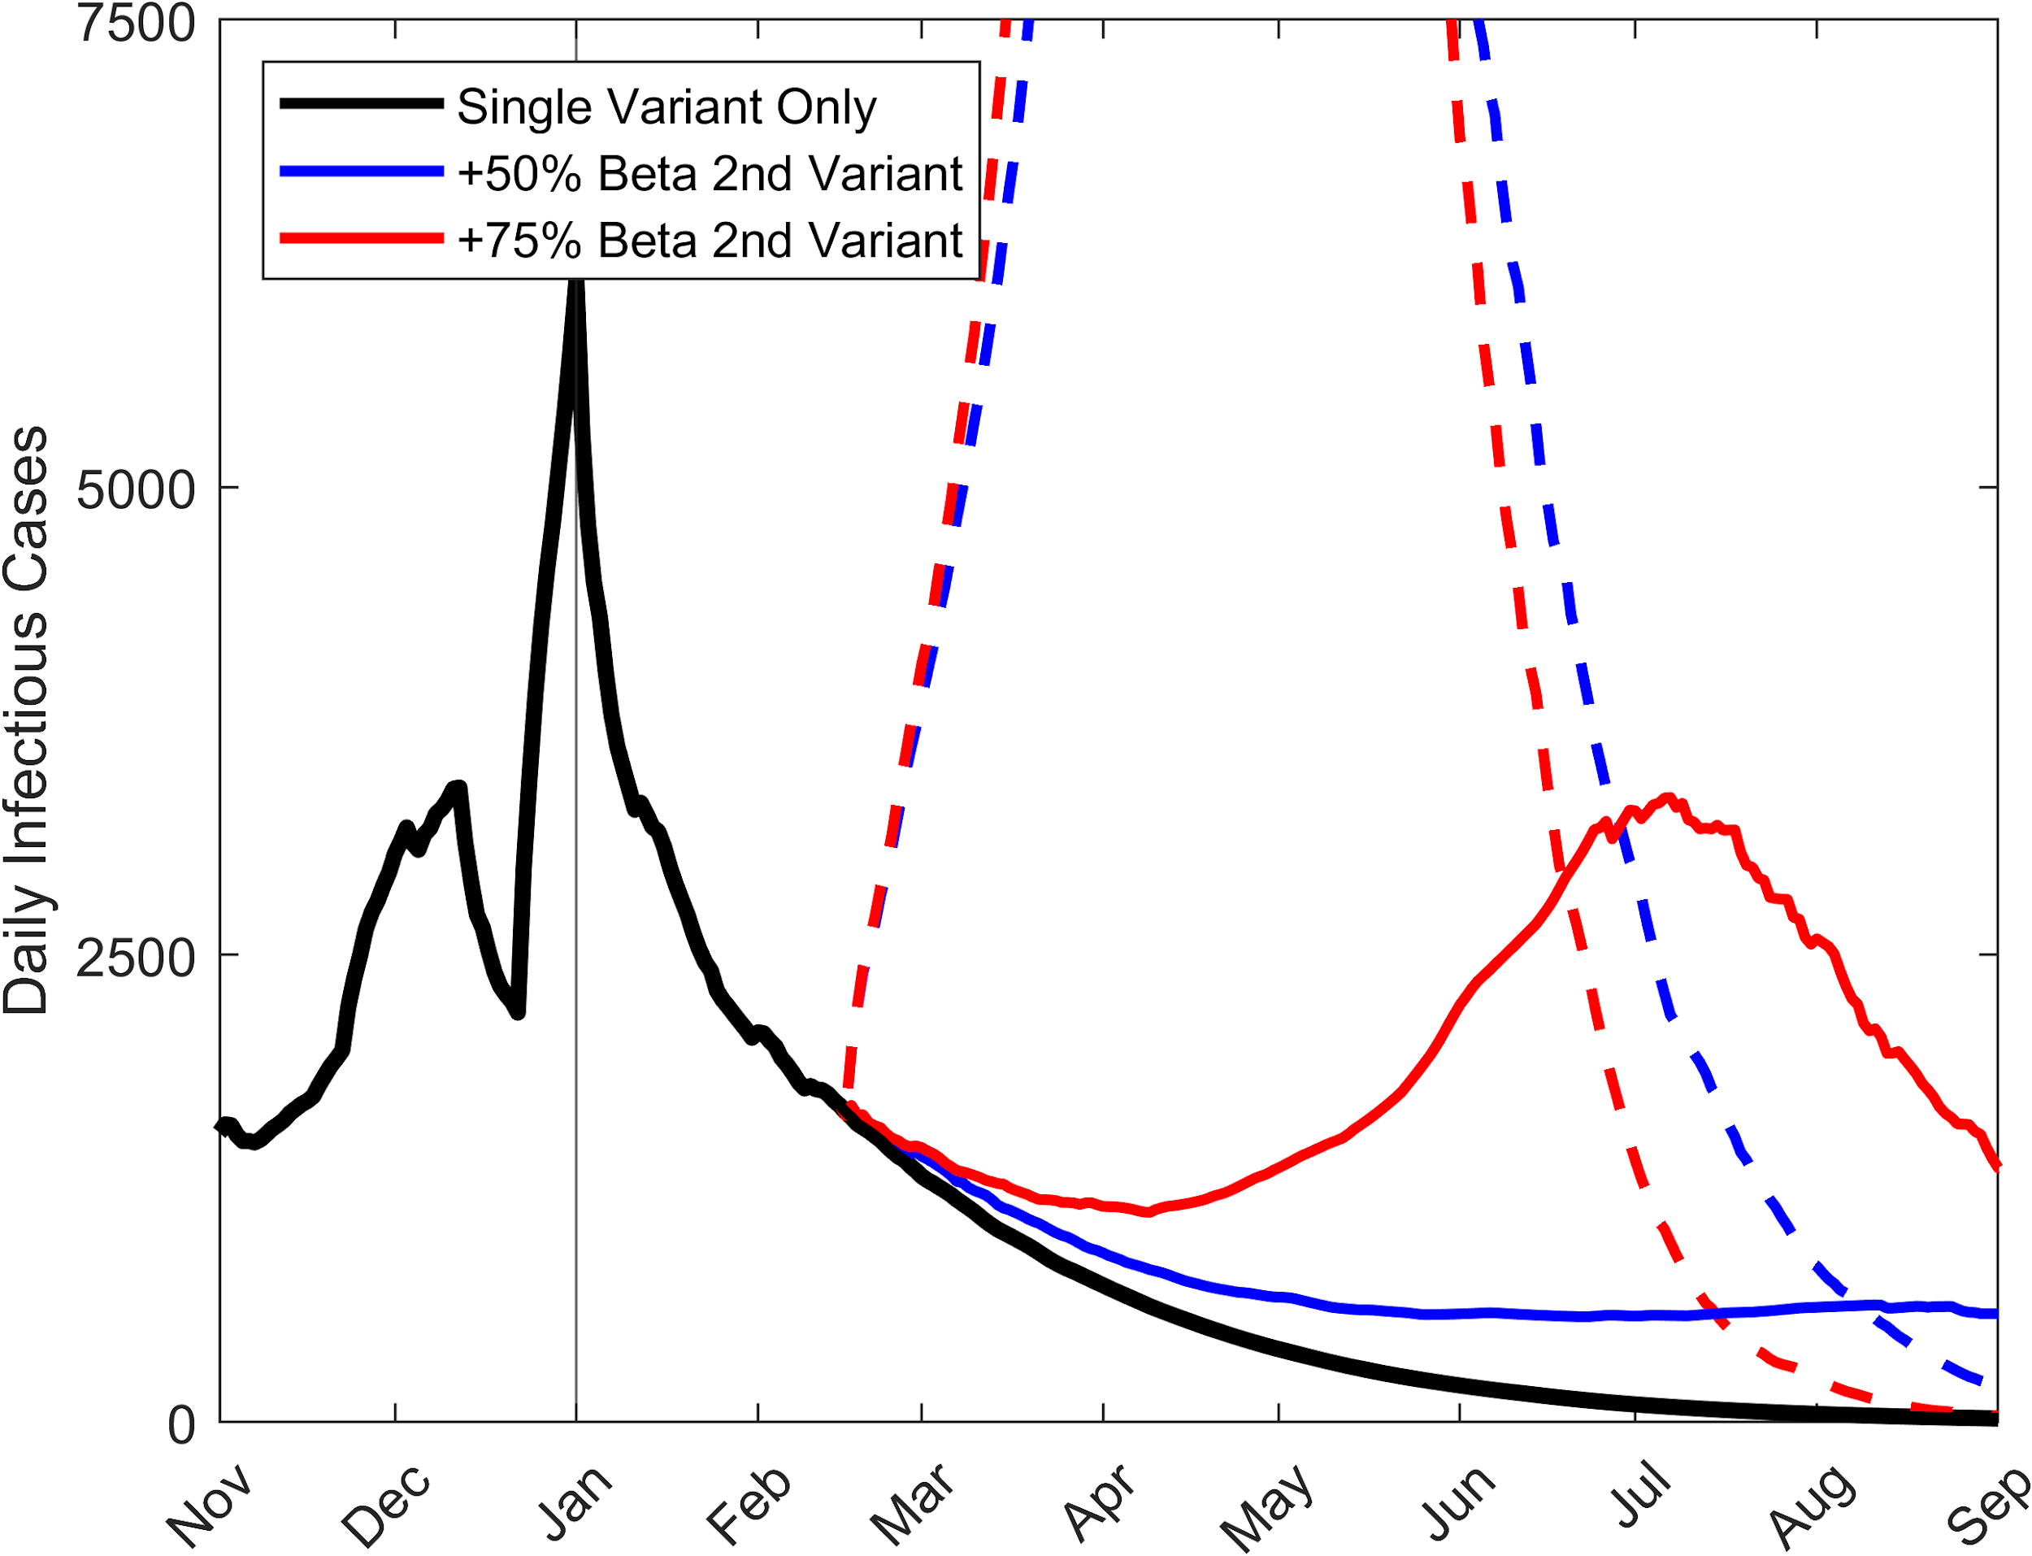
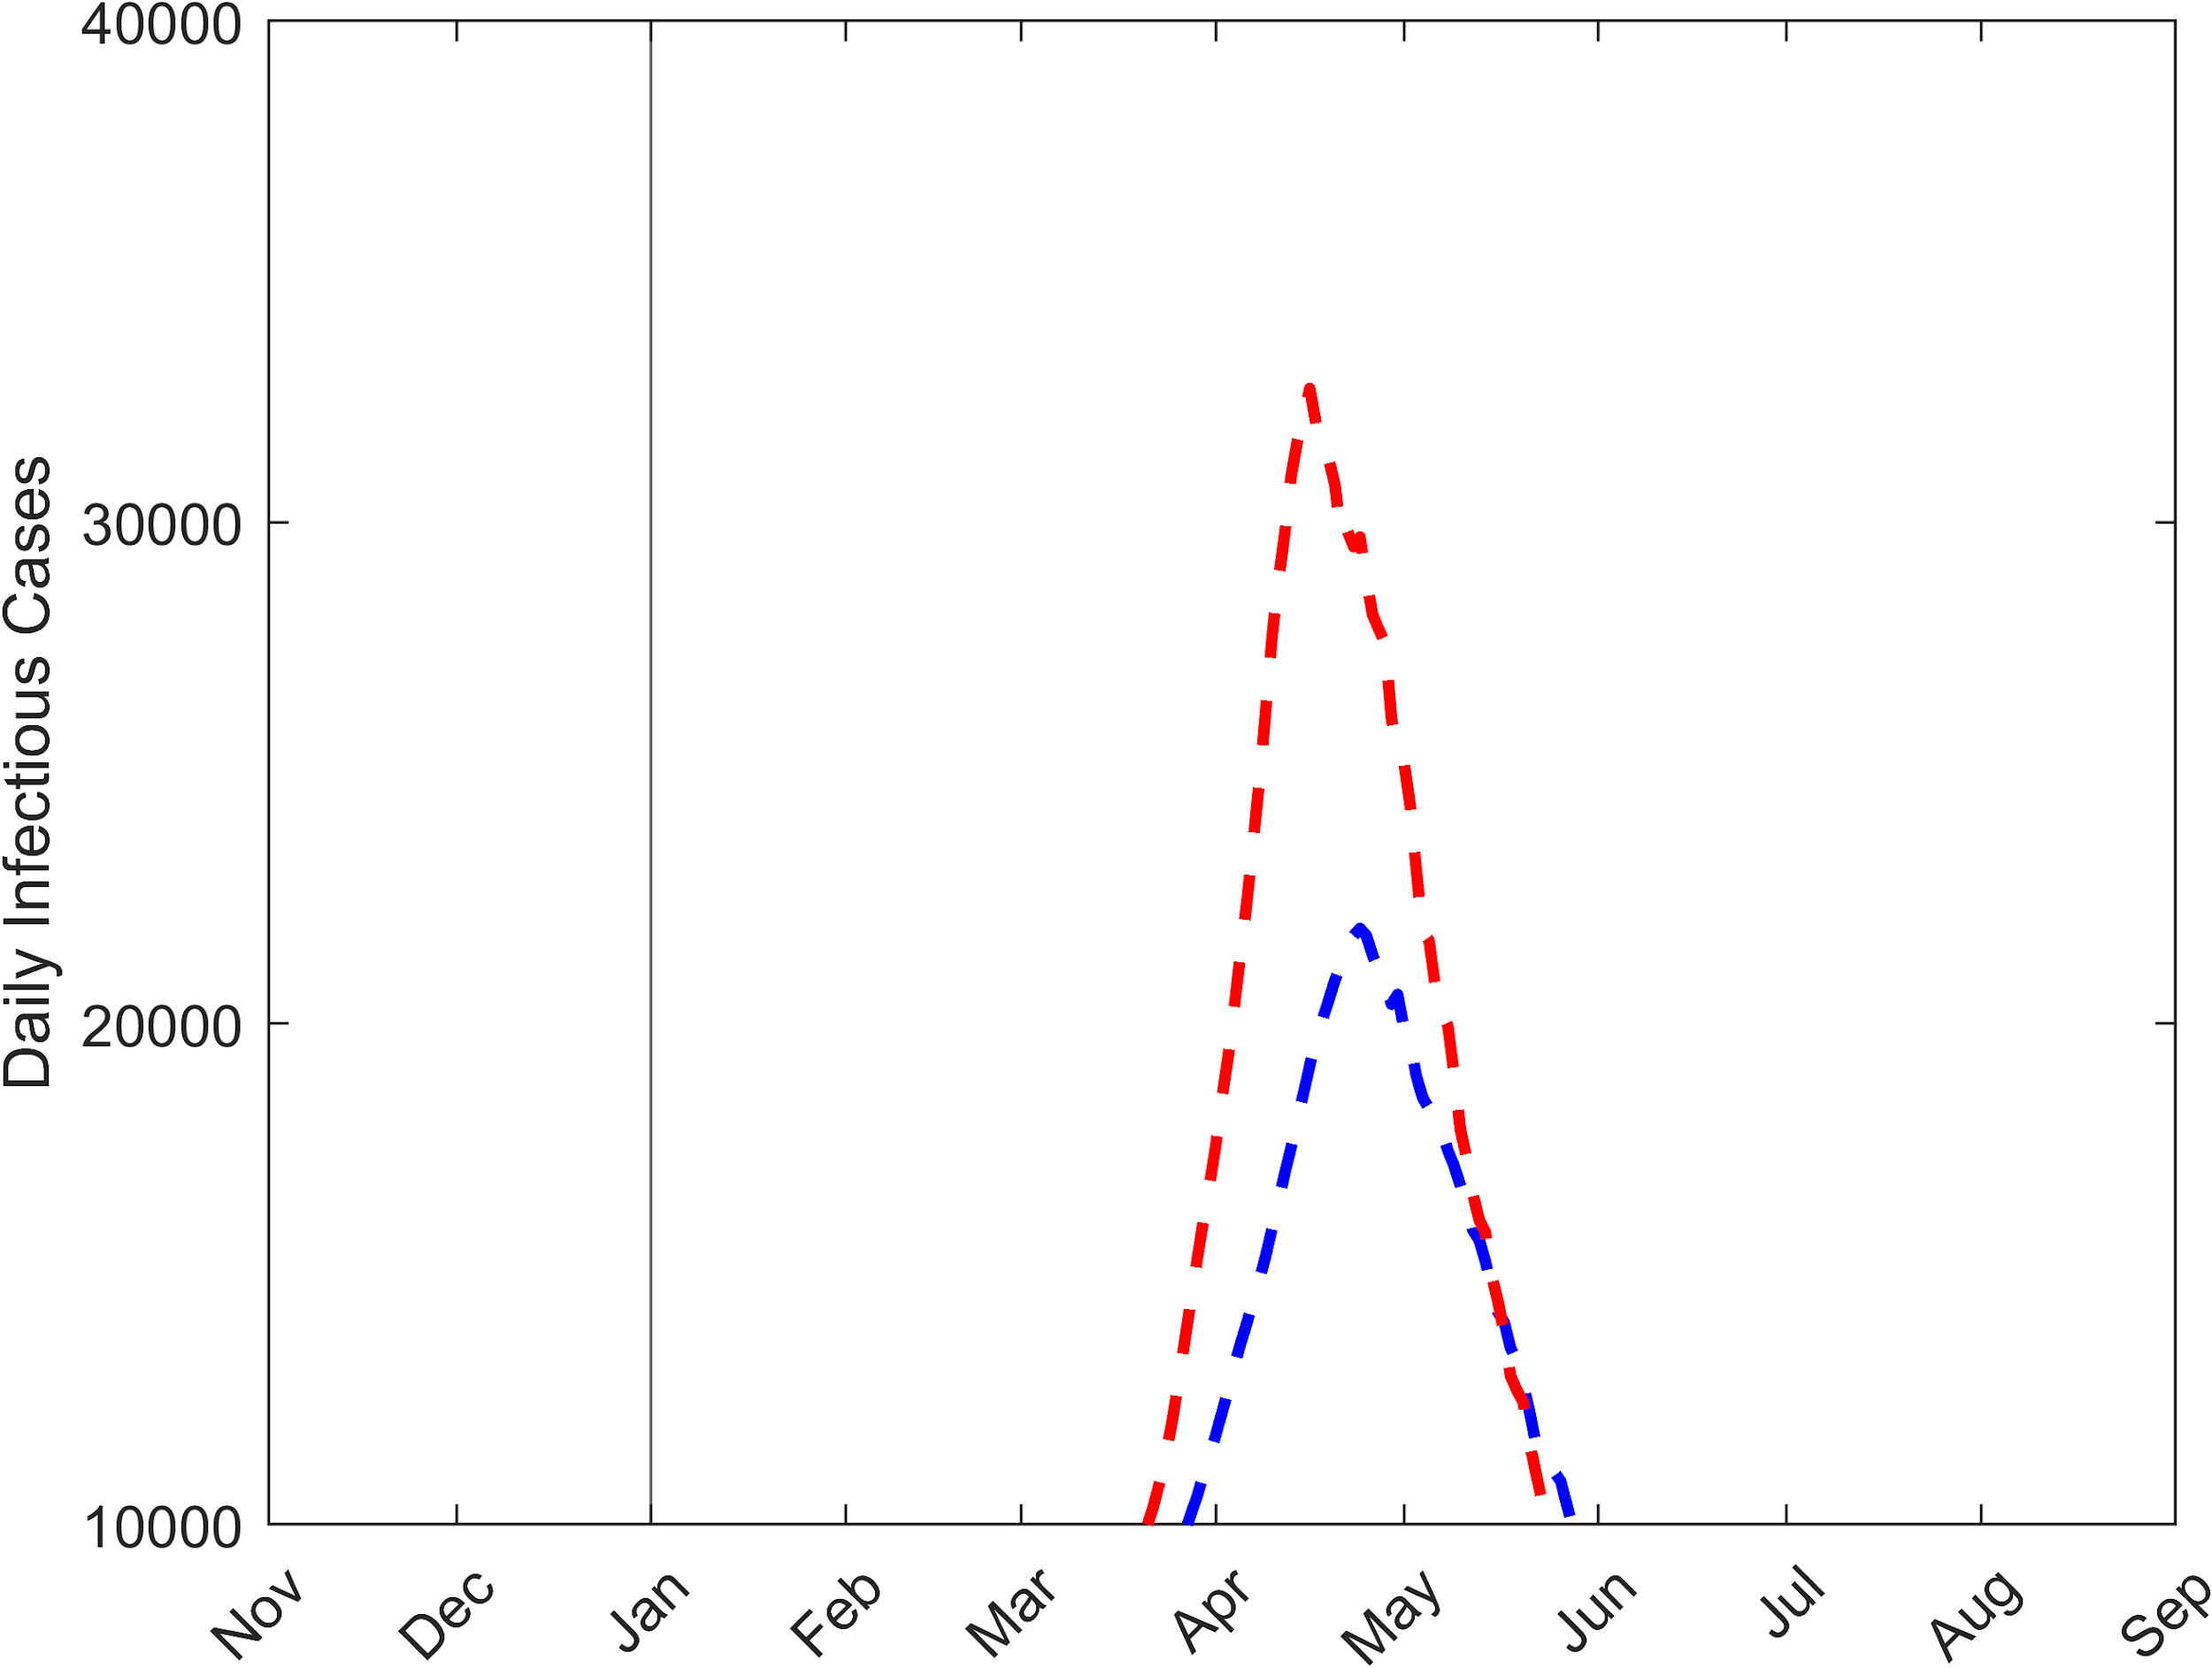
2-Variant Model Forecasts: impact of 50% release of social measures for 2 rates of transmissibility
Daily Infectious Cases
50% release of
social measures
10x > cases rel to w. current social measures
Release of the currently applied social measures will result in an explosive spread of the 2nd variant
Notes:
Single variant,
New variant
Single variant + new variant

Slide 18
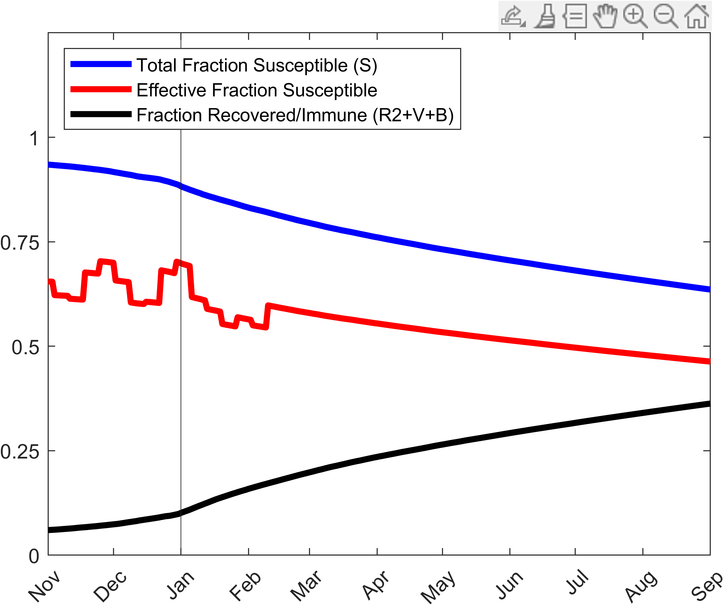
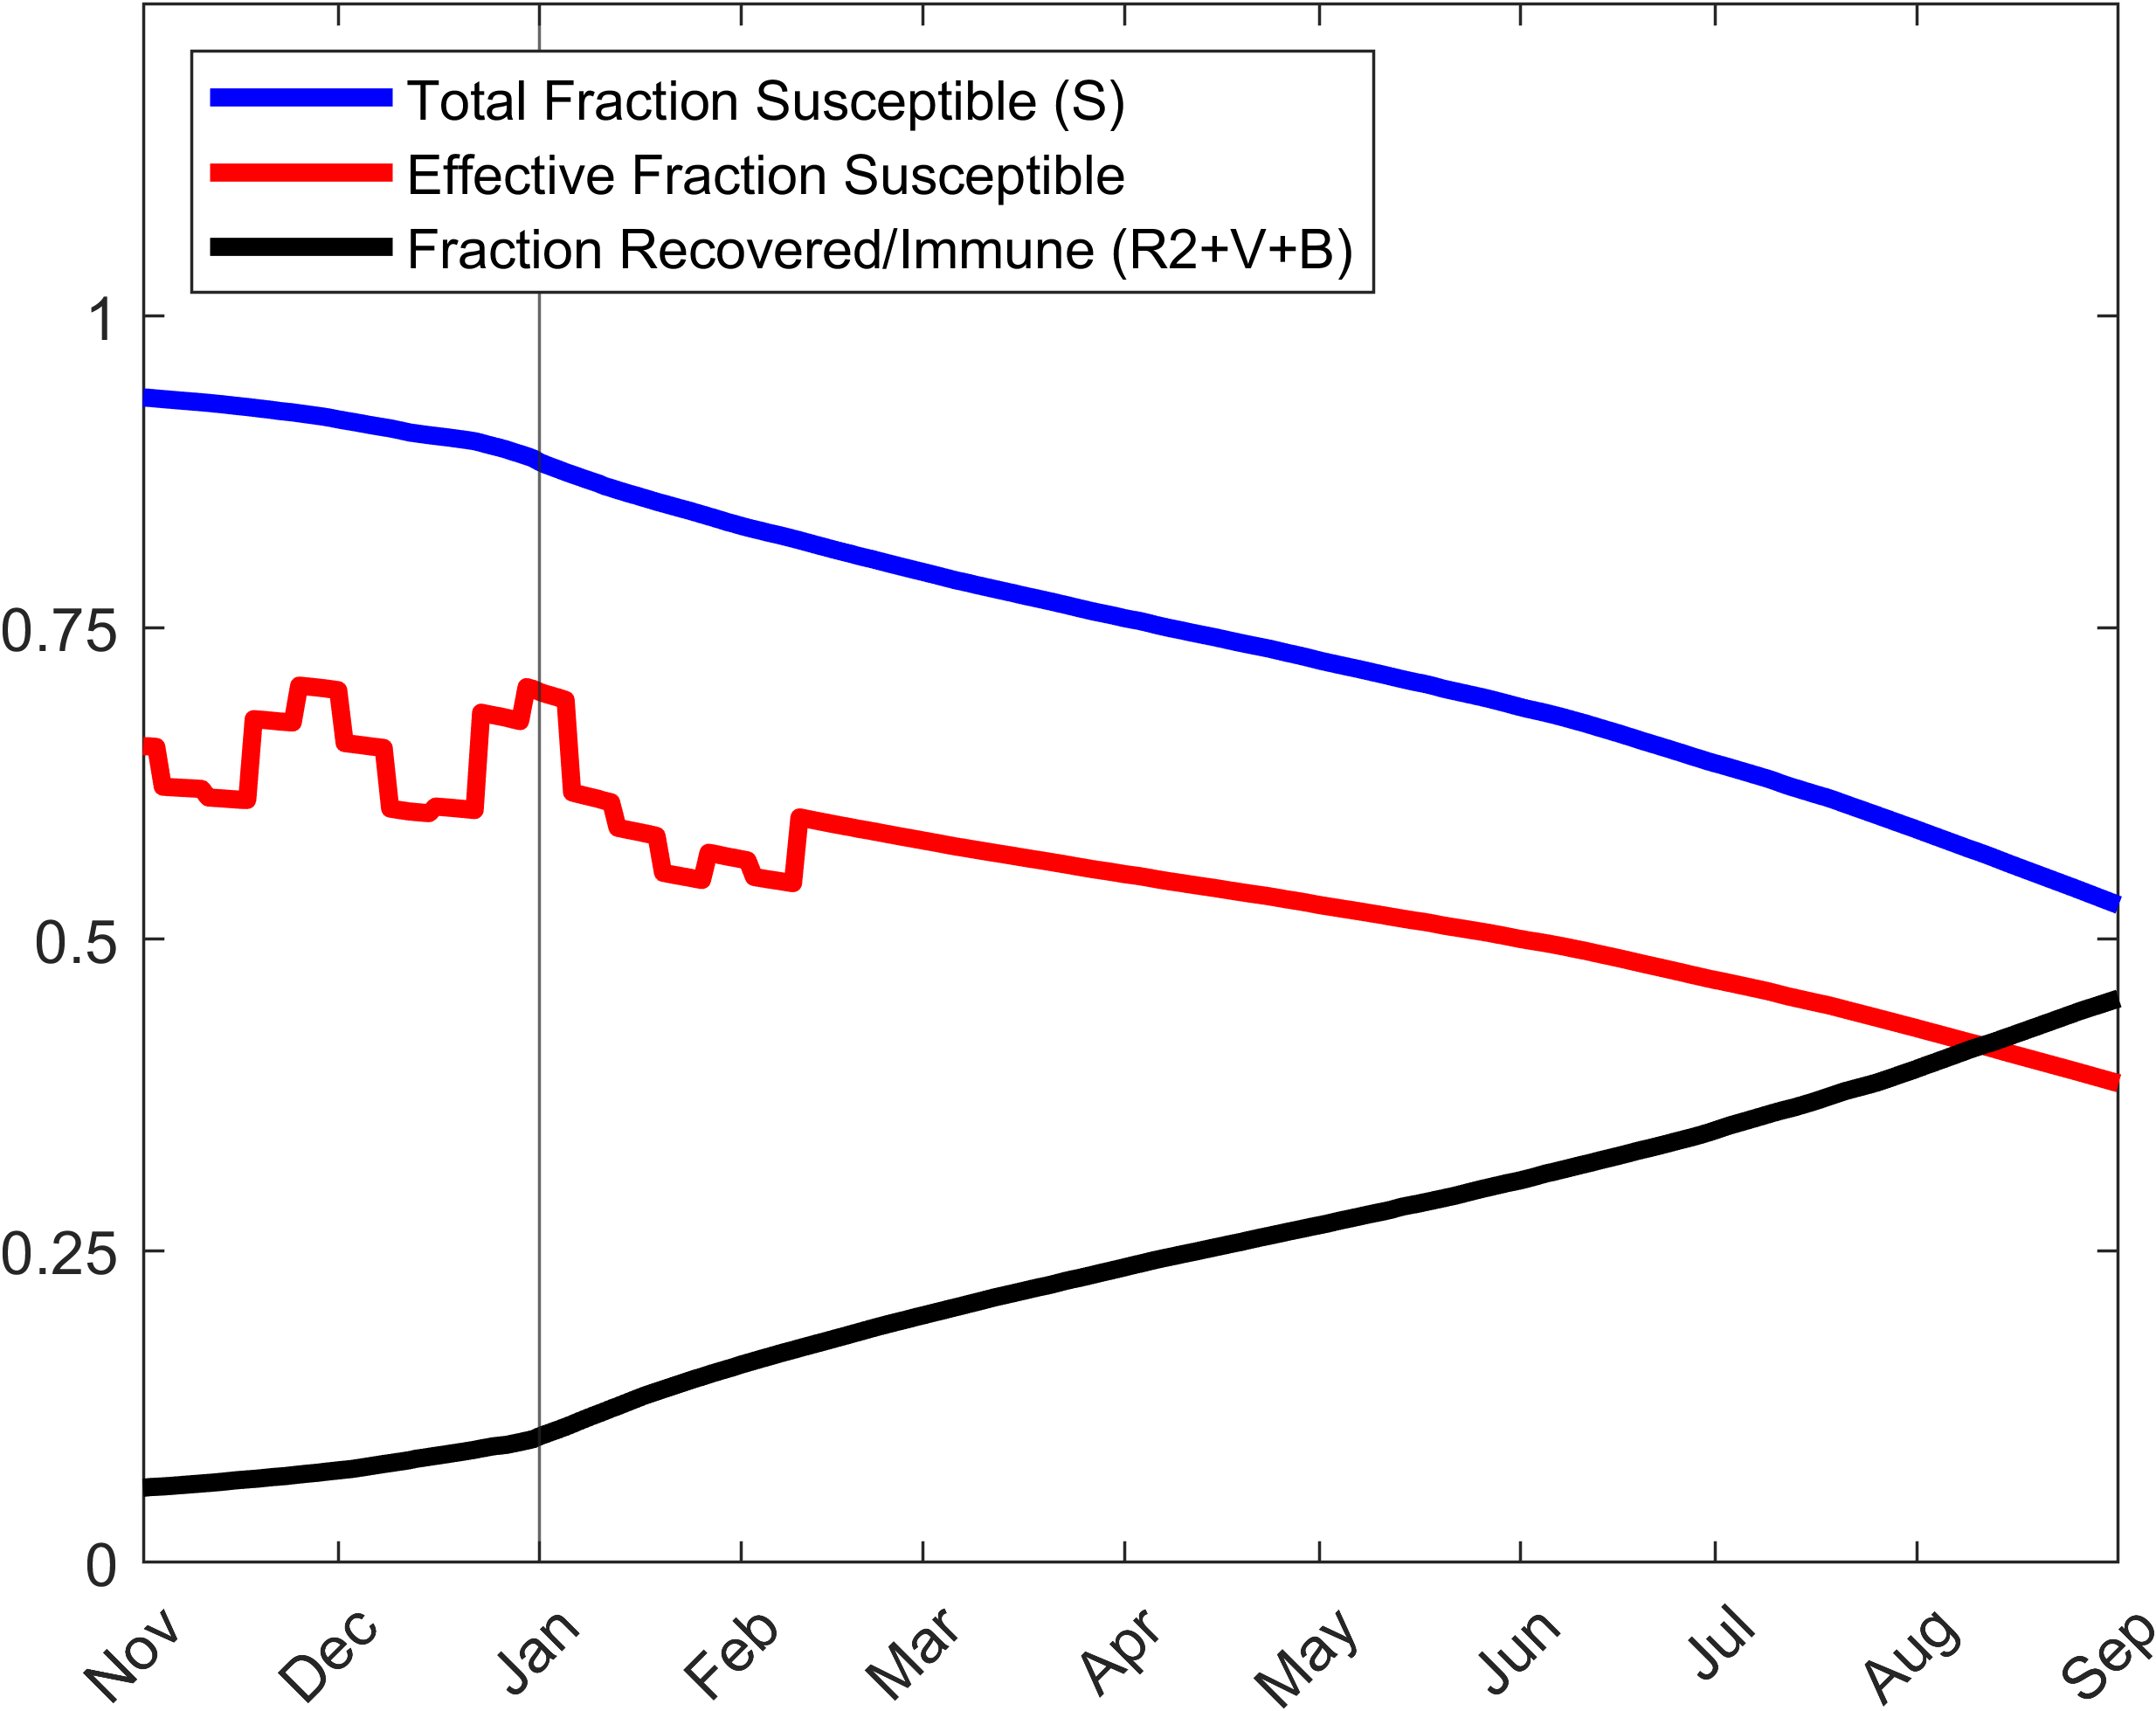
SEIRcast forecasts of the Susceptible and Immune Populations to the end of Sept 2021 given current beta and vaccination roll out rates
Assuming 65% effective vaccine, 80% effective booster
Single Variant
w/ 2nd Variant, +75% beta
Paradoxically, the faster spread of the 2nd variant will lead to faster development of population immunity and a faster depletion of susceptibles such that by mid Aug herd immunity under current social measures will be achieved (just under 50% population immune). Herd immunity to end the pandemic when all social measures are released will also be achieved in Nov (approx. 65% pop immune)
Notes:
S*d*beta
Total susceptible = (S+M)

